Slide 1
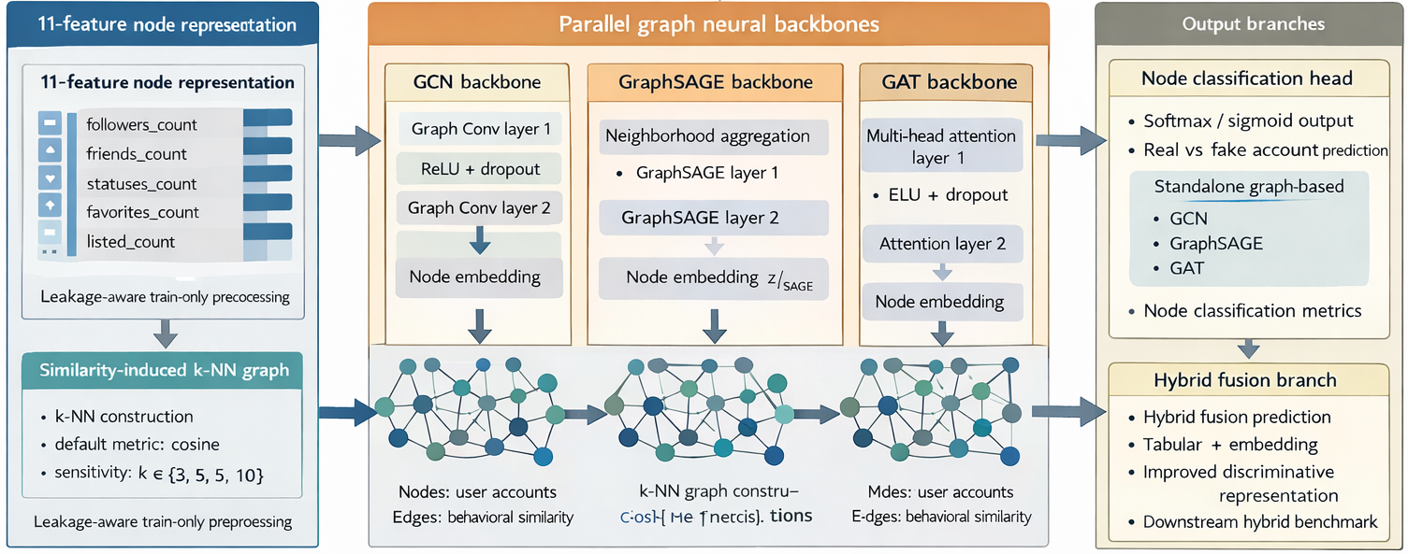
11-feature node representation
Parallel graph neural backbones
Output branches
K-NN graph constructions

